Slide 1


Data, Decision-Making and
Improving Outcomes
Missouri Asthma Prevention and Control Program
Peggy Gaddy, RRT, MBA Benjamin Francisco, PhD, PNP, AE
peggy.gaddy@health.mo.gov franciscob@health.missouri.edu
Sherri Homan, RN, PhD Paul Foreman, MA, MS, PhD
sherri.homan@health.mo.gov foremanp@health.missouri.edu
Eric Armbrecht, PhD Tammy Rood, PNP, AE-C
earmbrecht@gmail.com roodtl@health.missouri.edu
®
October 12, 2011

Slide 2
Surveillance in Missouri
guided by data
Prevalence*
8.8% MO adults current asthma (2010)
  - up from 7.2% (2000)
10.9% MO children current asthma
Disease Severity (Health Service Utilization)*
Highest hospitalization rates: ages 1-4
Elevated rates until age 14,
lower between age 15-44
Significant for African-Americans
*Missouri Department of Health and Senior Services. Missouri Information for Community Assessment (MICA) and Behavioral Risk Factor Surveillance System http://health.mo.gov/data/brfss/index.php

Slide 3
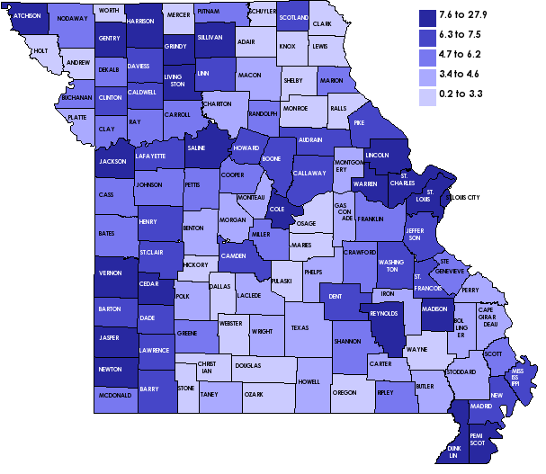
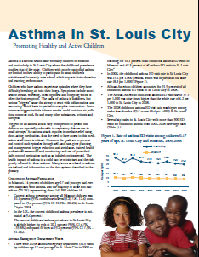

Surveillance in Missouri
guided by data
Prevalence*
19.6% St. Louis City children current asthma (2008)
Disease Severity (Health Service Utilization)
Significant for African-Americans
ER visit rate almost 3x higher
Rural vs. Urban
ER visits for children
highest rates in urban
counties
High hospitalization
rates for rural counties
ER Rates for Asthma Children (age 0-14), 2007-2009*
*Missouri Department of Health and Senior Services. Behavioral Risk Factor Surveillance System and MICA.

Slide 4
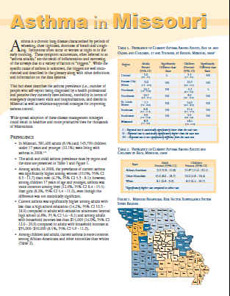
Surveillance in Missouri
guided by data
Asthma in Missouri
Hospital charges of $96 million (2008)
MO Health Net covers about one-third of all asthma ER visits and hospital stays
Longer length of hospital stay for Medicare recipients
Pay Source | Average Asthma Hospital Days of Care (2000-2008)
Medicare | 4.3
Workers’ Compensation | 3.6
Commercial | 2.9
Medicaid | 2.4
Self-Pay | 2.4
Missouri Information for Community Assessment

Slide 5
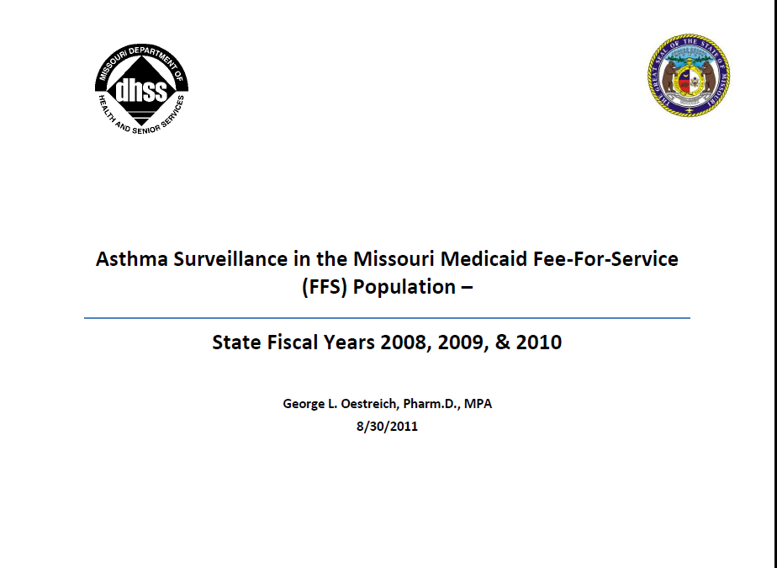
Surveillance in Missouri
guided by data
Medicaid (aka, MO Health Net)
Persistent asthma age 0-64 (SFY 2010)
Prevalence FFS Medicaid: 11.3%
  up from 10.6% (SFY 2008)
Met at least one criteria in a year:
  Four or more asthma prescriptions
  One or more ER visits or hospitalizations with primary diagnosis of asthma
  Four or more outpatient visits with asthma as a listed diagnosis and at least two asthma medications
*Missouri Department of Social Services, Mo Health Net

Slide 6

Surveillance in Missouri
guided by data
Medicaid
Persistent asthma age 0-64 (SFY 2010)
Acute care utilization
10.4% sought care at ER
3.2% had an inpatient hospital stay
30.6% had at least one office visit
Overall cost estimated $46 million
*Missouri Department of Social Services, Mo Health Net

Slide 7
Surveillance in Missouri
guided by data
Medicaid (MoHealth Net Data Project)
Persistent asthma ages 6-18
36.4% received inhaled corticosteroids and national average is 79.8% (Arellano, et al, 2011)
24.0% ICS medication possession ratio (MPR) adherence for all ages (SFY 2010)
$ 2574 paid for medication per persistent asthmatic child annually
Poor ICS medication use and adherence contributes to acute care utilization
*Missouri Department of Social Services, Mo Health Net

Slide 8







Successful Strategies
& Promising Interventions
just do it.
MAPCP interventions are designed to support sustainable asthma care improvements by focusing* on workforce development
and community-based leadership.
* but not exclusively, of course
Tools for Schools

Slide 9


just do it.
IMPACT Asthma Kids© Care
®
Background
Improvement of School Asthma Services
  - partner with DHSS over the last decade, contract nurses, MASN
Asthma Ready® Clinics
  - clinic staff including physicians, nurse practitioners, nurses, receptionists/billing clerks and respiratory therapists receive asthma standardized medical management curricula, equipment & protocols
Asthma Ready® Schools
  School nurses trained, standardized curricula
  School assessments and interventions are based on EPR3 guidelines
  Actionable data are documented and sent to the parents and PCP (should be in real time)

Slide 10
just do it.
School /Clinic Based IMPACT Programs
®
Based on dyad approach – clinic and school district in proximity prepared to deliver care
Rural and urban school districts identified as having the highest persistent childhood asthma rates and level of health risk in Missouri
Identify targets by matching the zip codes clinic sites of Federally Qualified Health Centers (FQHC) and Asthma Ready Clinics (includes Medical Homes) with local school districts
School nurses (17% of 1,600 total) who expressed interest in IMPACT programs after receiving 2011 Missouri School Asthma Manual
School District
Child &Family
Clinic

Slide 11
just do it.
Education & Care based on
Real Need + Right Service at a Reasonable Cost
®
Message Type | Audience | Cost
1) Asthma Literacy - 4 concepts | Student w/asthma (school-based) | Low ($5-25)
2) Key Messages - EPR3 defined | Patient and family (medical home) | Low (bundled)
3) Risk Reduction - 99402 and 99401 | Patient and family (medical home) | Medium ($40, $20 x 2 = $80)
4) Self-management - 98960 | Patient and family (multiple settings) | Medium ($100)
Stratified = Intensity “cost” of care is appropriate for burden of disease (not just the dollars already spent on health care)

Slide 12
just do it.
Education & Care based on
Real Need + Right Service at a Reasonable Cost
®
Message Type | Program | Reach | Funding
1) Asthma Literacy - 4 concepts | Teaming up for Asthma Control | 1K school nurses | CDC/MFH $900K
2) Key Messages - EPR3 defined | Asthma Ready® Clinics | 100 ARC, 500 MH | MFH/DHSS $300K
3) Risk Reduction - 99402 and 99401 | Counseling for Asthma Risk Reduction | 500 Medical Homes | DHSS $150 K
4) Self-management - 98960 | ABC (caregivers) ACE (school-age) | 1000 - 0 to 5 1200 - 6 to 12 | DHSS $100K MFH $100K
Stratified = Intensity “cost” of care is appropriate for burden of disease (not just the dollars already spent on health care)

Slide 13
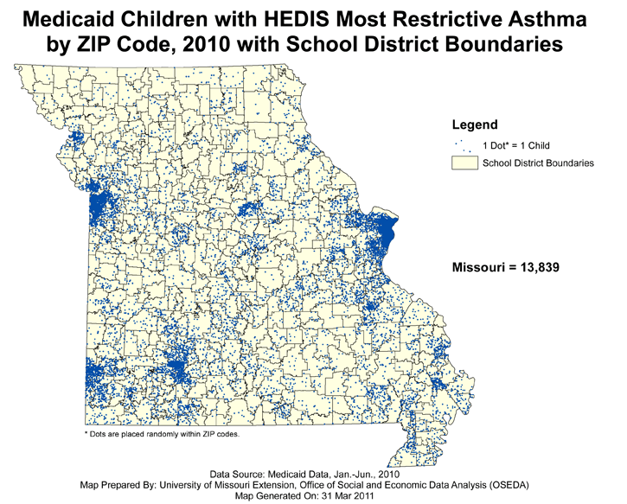

Successful Strategies
®
& Promising Interventions
just do it.
14,000 Medicaid kids
HEDIS
1) ER
2) Inpatient
3) 4 Outpatient & >1 Rx,
4) >3 asthma Rx dispensed
(by school district)

Slide 14
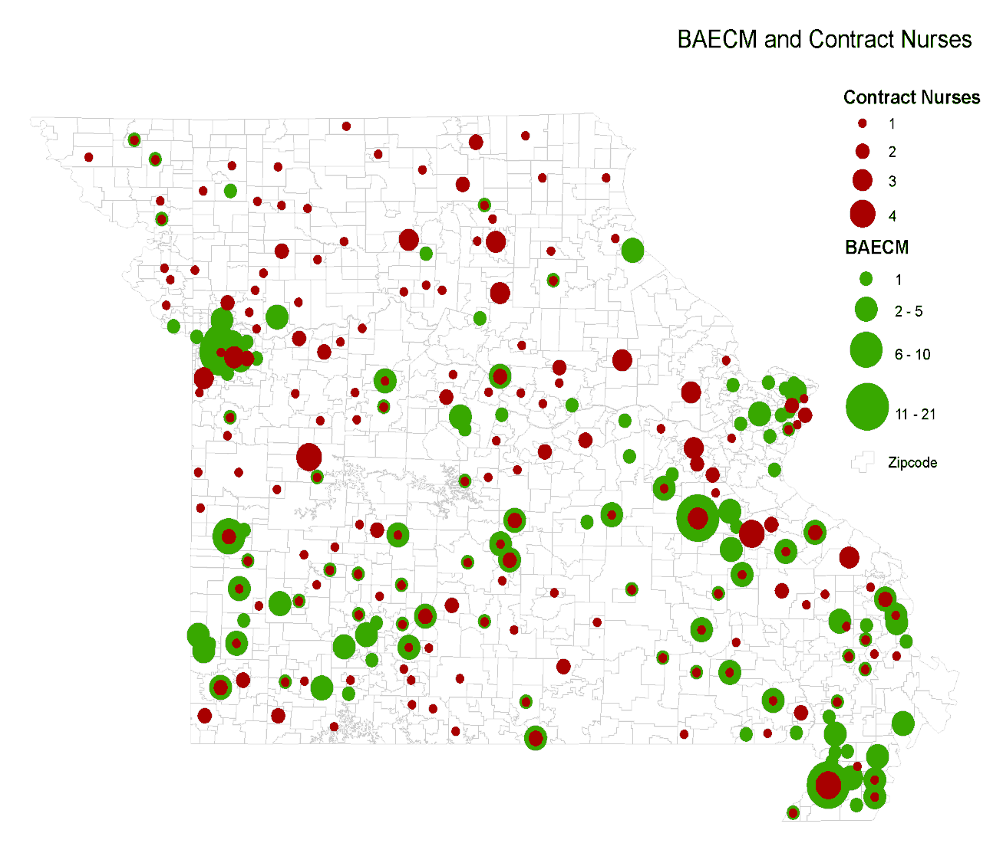
Successful Strategies
®
& Promising Interventions
just do it.
Missouri Asthma Educator Network-Credentialed Health Professionals
More than
1,400 trained
mid-level
(6 hours)

Slide 15

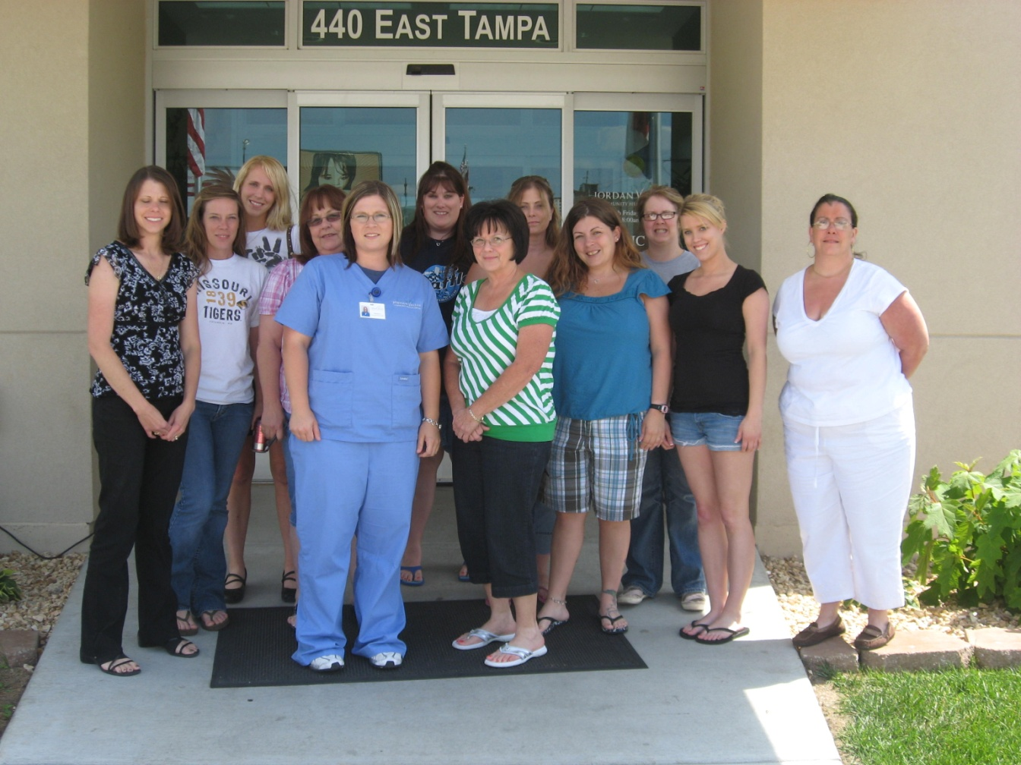
®
just do it.

Slide 16
Self and Medical
Management Interventions
just do it.
®
IMPACT Asthma Kids©
  a multimedia, self management education program for students and parents (recognized by NIH as 1 of 3 evidence-based computer approaches)
Teaming Up for Asthma Control©
  an IMPACT derivative for asthma literacy, funded by CDC, uses a standardized student assessment to guide school nurse documentation of actionable asthma data
Assessment
  functional impairment (selected items from the Children’s Health Survey, for Asthma, American Academy of Pediatrics)
  FEV1
  inhalation technique
  recognition and adherence to ICS medications for messaging parents & primary care providers

Slide 17
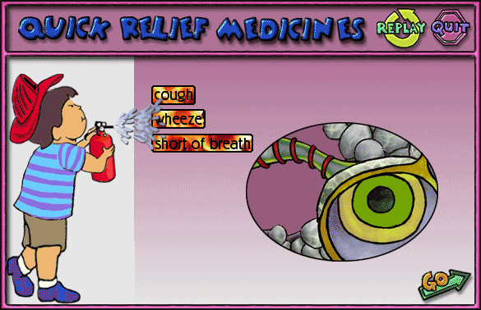
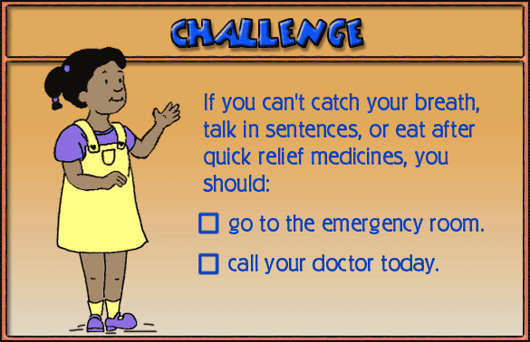
Student Asthma Literacy
Teaming Up for Asthma Control©
just do it.
®
IMPACT Asthma Kids©, evidence-based

Slide 18
TUAC Evaluation Methods and Initial Results
just do it.
®
Pre-Post TUAC intervention outcome indicators for these children were derived from 2008, 2009, 2010, 2011
Medicaid data:
  asthma outpatient visits
  ER visits and hospitalizations
  medication claims
  per member per month (PMPM) categorical costs
Missouri Department of Elementary and Secondary Education (DESE) attendance and achievement records
87 children participated. After TUAC intervention FEV1 significantly improved by 14.7%, inhalation technique improved significantly, student-reported impairment and smoke exposure declined significantly.

Slide 19
New, Compelling Asthma Outcome Variables
just do it.
®
ACD Acute Care Day Score
ACD is defined as the number of days
of acute care events in a given time period
  If ACD = 6
  6 ER visits
  6 inpatient days or
  3 ER visits & 3 inpatient days

Slide 20
New, Compelling Asthma Outcome Variables
just do it.
®
POPT
  Proportion (P) of Outpatient visits (OP) to Total visits (T) including OP, ER visits & inpatient days
  expressed from 0 to1
  where
    “0” is the worst case scenario (no outpatient visits, all asthma encounters are in acute care settings)
    “1” is the best case scenario (only OP visits)
Example
1 OP visit and 9 ER visits
1 OP / 1 OP + 9 ER =
0.1 POPT
Or
10%

Slide 21
New, Compelling Asthma Outcome Variables
just do it.
®
DPR Dose Possession Rate
Daily amount of drug (i.e., inhaled corticosteroids) available over a dispensing interval
Charting ACD, POPT & DPR to model opportunities for family member, PCP and school nurse messaging
Data available within one month of event for timely actions

Slide 22

New, Compelling Asthma Outcome Variables
just do it.
®
DPR charts change trajectory of care
Micrograms of asthma medication and EPR3 ICS dose ranges are plotted on the y axis by EPR3 guidelines
  by age, sub-therapeutic, low, medium, high or very high
Asthma ACD (ED and IP days) are plotted on the x axis (time)
POPT is calculated and displayed. DPR graphed by actual dispensing interval, by year & 90 day
Trajectory of delivered asthma health care can be analyzed and appropriate interventions prompted by messaging members, PCPs and school nurses

Slide 23
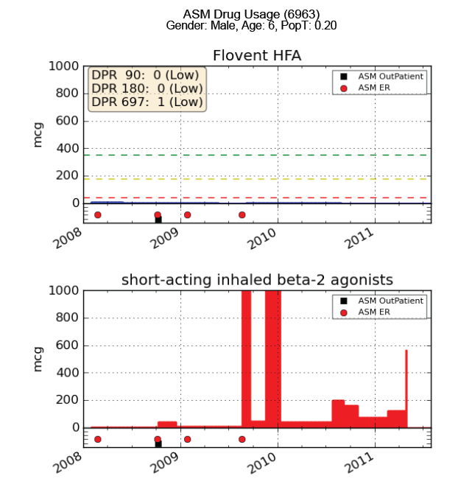
just do it.
Sub-therapeutic doses of ICS, low PopT, high ACE, high SABA

Slide 24
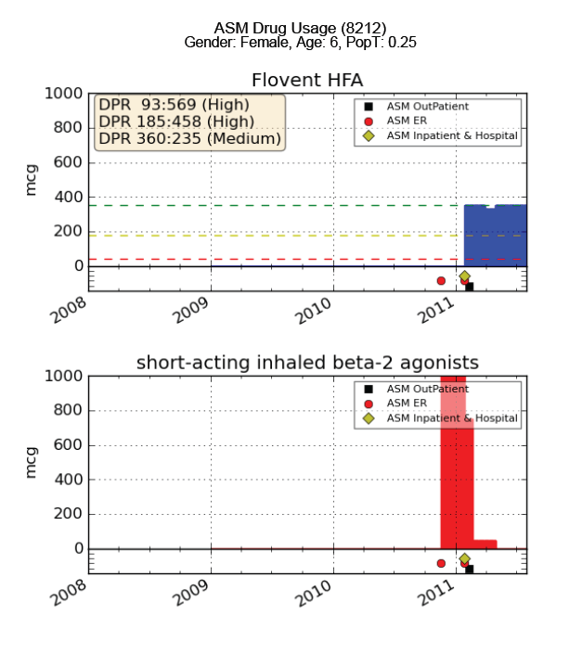
Two ER visits, starts ICS,
SABA use drops
just do it.

Slide 25
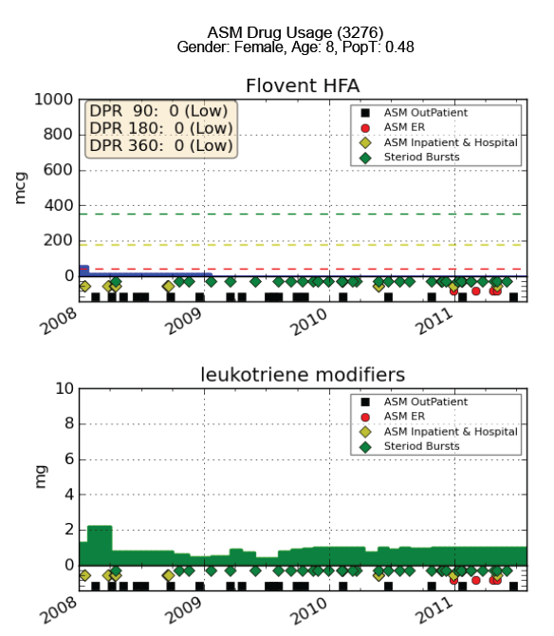
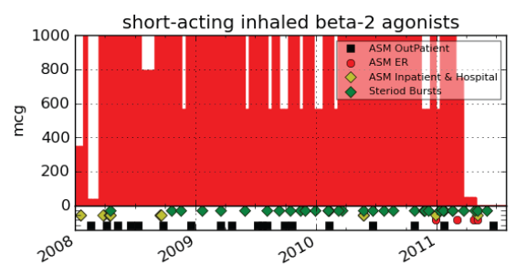
High ACE > 11, 31 oral steroid bursts, sub-therapeutic ICS, high SABA, high cost
just do it.

Slide 26
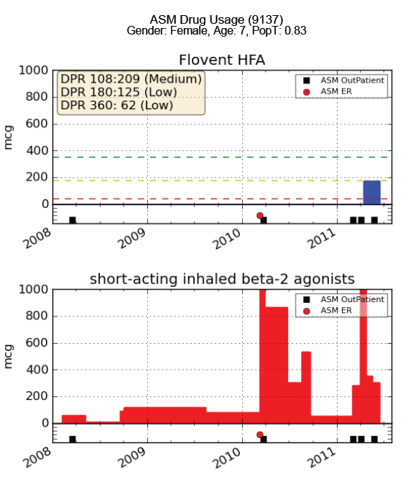
ACE =1 (ED visit), high SABA, PopT = 0.83,
TUAC participation, medium dose ICS
just do it.

Slide 27
Intervention Data Messaging Capacity
just do it.
Initial TUAC assessments are analyzed by EPR3 algorithms to suggest additional assessments and interventions by the school nurse
Children are categorized into three zone classifications of EPR3→
Parents and PCPs are alerted by school nurse regarding findings in timely manner
All clinical interventions are collaborative with goal of moving children into the GREEN zone over time. An expert support system is needed to provide resources, analysis and messaging (ARC)
Well Controlled
Not Well Controlled
Very Poorly Controlled

Slide 28
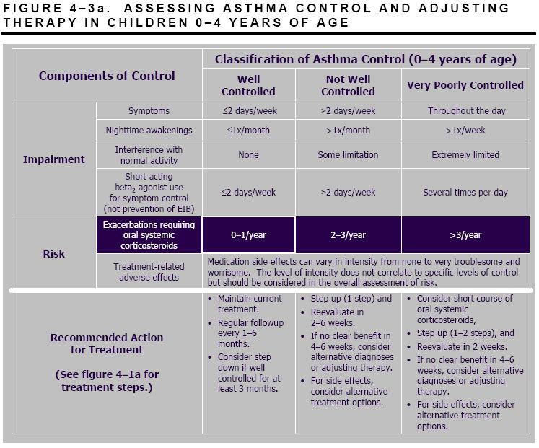
Clinicians Assess Impairment & Risk
just do it.

Slide 29
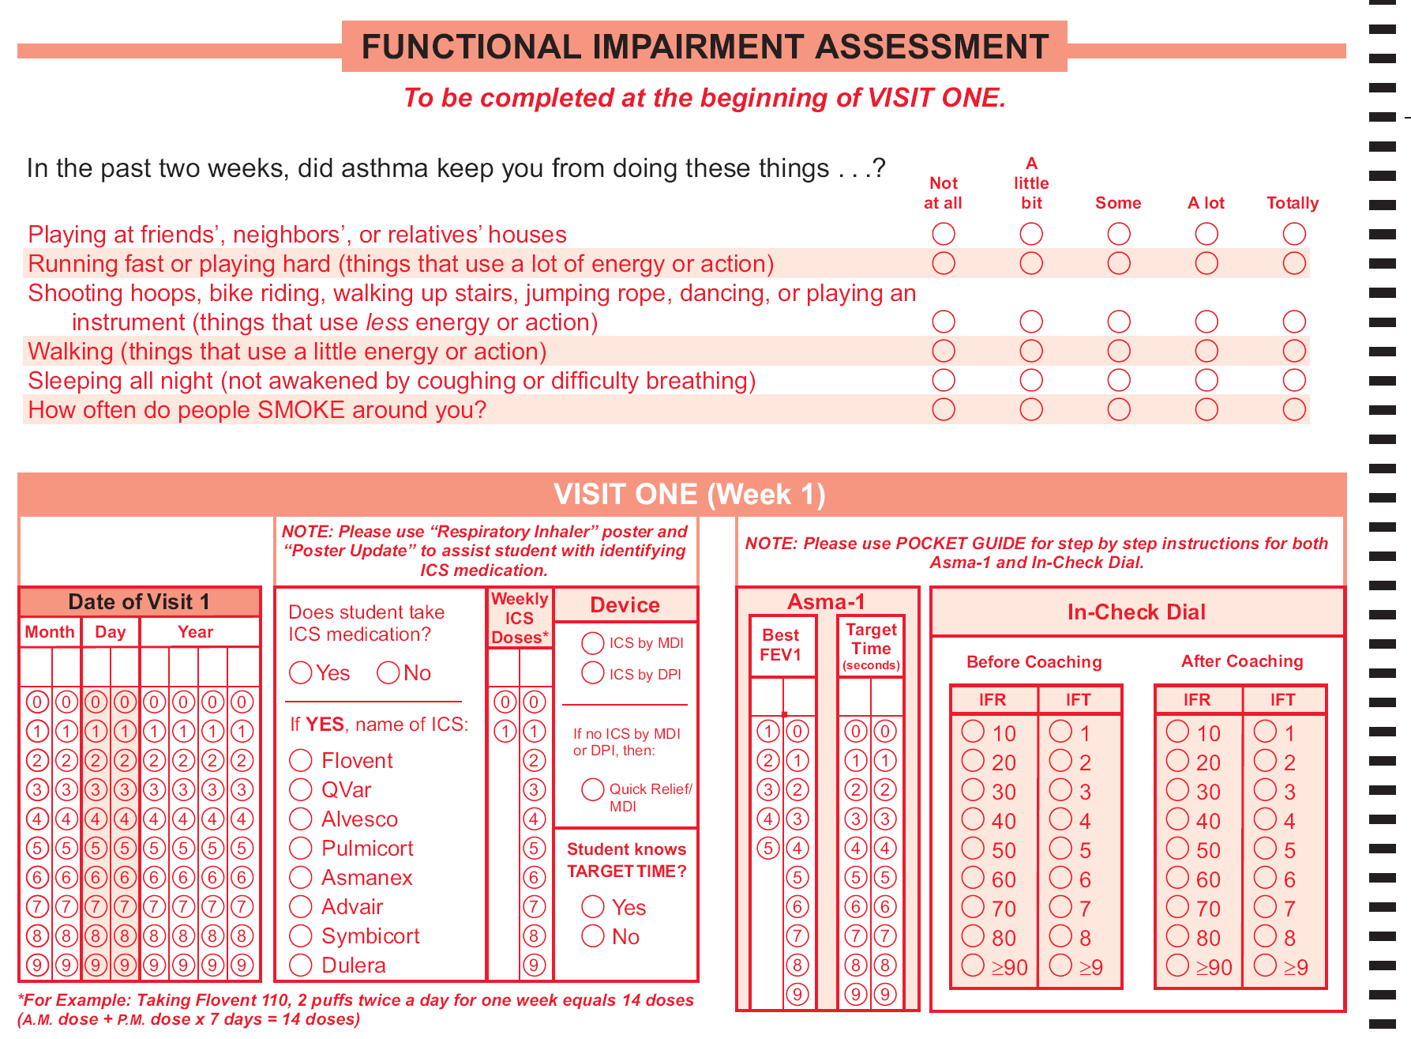
School nurses assess impairment & risk
just do it.

Slide 30
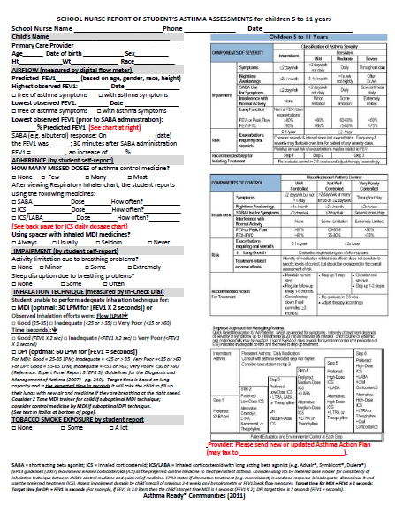
School Nurse Messages PCP
just do it.

Slide 31

Students Receiving Award for
Finishing Asthma Education
just do it.

Slide 32
Changing Outcomes for Missouri Children with Asthma:
MO Health Net Collaboration
just do it.
Identify populations of children suffering from the most severe asthma
  Claims: high ACD, low POPT, sub-therapeutic ICS, higher cost of care
  School: exacerbations, low FEV1, high impairment, high absenteeism
Train local school and clinic (including medical homes) dyads in EPR3 guidelines for care using standardized curricula
Continuously analyze school & claims data to deploy and stratify interventions to meet their needs and the family circumstances
Produce actionable data for key providers
Track individual and aggregated outcomes and evaluate using advanced scientific methodology

Slide 33
Changing Cost Outcomes for Missouri Children with Asthma:
MO Health Net Data Project Collaboration
just do it.
Per member per month (PMPM) costs for children ages 5-18 identified with persistent asthma was $1,497 for 6,577 participants in 2010.
Per member per month costs for children ages 5-18 was $1044 for 134 patients of an EPR3-compliant practice in 2010.
EPR3-treated group costs were 9.6% higher for ICS medication costs and 17% higher costs for treating co-morbid conditions when compared to population mean.
However the total asthma direct costs were 4.7% lower for EPR3-treated group.
Remarkably, total asthma medication costs were 33% lower and total cost of care was 30% lower for the EPR3-treated patient group.

Slide 34
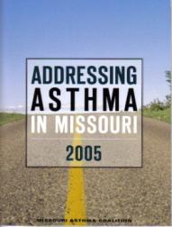

Partnerships
leveraged resources
MAPCP’s Role: Link statewide and local partners
Our Little Secret : Everyone is welcome, but MAPCP strategically builds partnerships to reach target population
Our Purpose for Partnership: Leverage resources … to the max.
HOW DOES PARTNERSHIP IMPROVE ASTHMA CARE?
Interdisciplinary Sharing: Expertise and resources
Coordination: Activities are planned and implemented together
Innovation: New ideas and collaborations are fostered between stakeholders
Priorities: Partners set priorities for surveillance and interventions
Relevance: Key asthma issues move to forefront of systems-based
strategies and public health planning
State Plan 2005
State Plan 2010
Note:
CDC’s $3.4 million investment in MAPCP (2001-2011) has helped produce a
>$20 million investment from MAPCP partners in activities aligned with the State Plan Putting Excellent Asthma Care Within Reach.

Slide 35
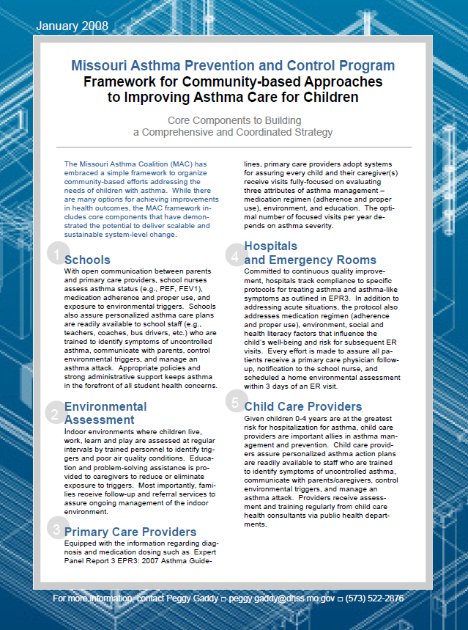
Local + Statewide =
Sustainable Interventions
systems thinking
Dunklin Co. (Kennett) pop.= 31,039
LOCAL STRATEGY EXAMPLE
Framework for Community-based Approaches to Improving Asthma Care for Children
  Simple, to-the-point, one-page summary
  Sets goals and interventions for integrating efforts in five areas: schools, home environment assessments, primary care providers, hospitals/emergency rooms, and child care
KEY CONCEPTS
Demonstrate success at local level
  Kennett Public Schools (Dunklin County)
  Springfield (Greene County)
Experience, testimonials and data drive expansion of successful ideas
Identify statewide policy change opportunities through community-based work (e.g., spacers)
Statewide workforce development produces system-level change (e.g., LPHA staff, school nurses)
Cultivate local leadership
  Asthma School Nurse Award, Missouri Asthma Coalition
Greene Co. (Springfield) pop.=269,630

