Slide 1
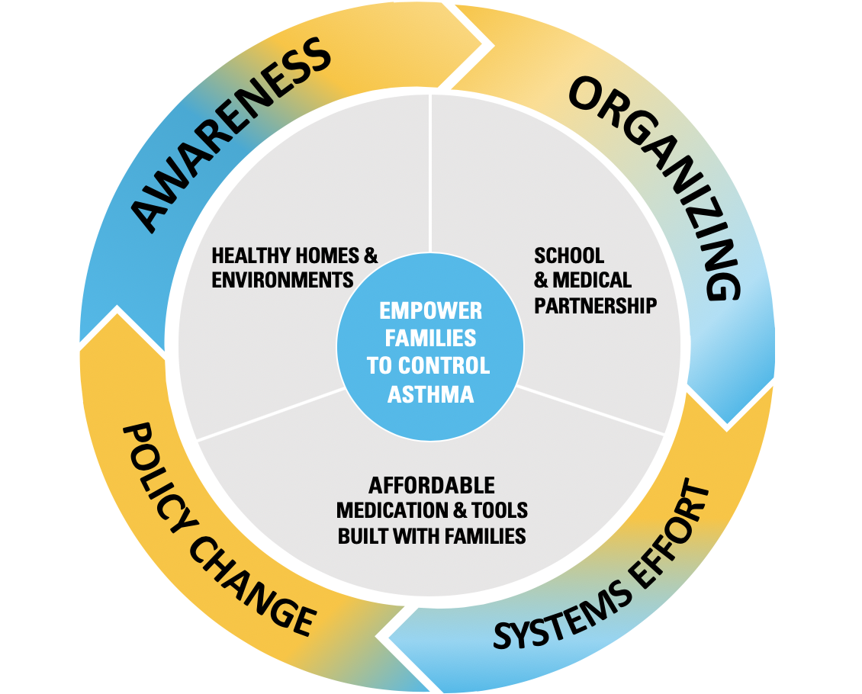
Our Bold Goal
Cut Kansas City’s uncontrolled asthma rate for children in half by 2030.
Our problem
50,000 Missed School Days because of asthma
2 or more children have died annually from asthma with no real improvement
African Americans are 5 times more likely to die of asthma than whites
How we will solve this
Partner with families to address the root causes
Asthma friendly homes must be breathable
Medications are affordable
Asthma Action Plans are designed for everyone
Schools and providers partnering better to support our families.
Who we are
We are a coalition of doctors, community partners, school districts, funders, and families united to fight asthma. Our vision is to cut the uncontrolled childhood asthma rate of our city in half by 2030. It will take regional partners working smarter and aligning around DATA to address this daunting goal. In 2019, United Way of Greater Kansas City graciously offered to be our fiscal home and align with regional school absentee efforts.
We believe Collective Impact is the right framework for Kansas City to address this complex crisis. That means we need:
A backbone staff waking up everyday to align partners.
A common method to measure our work and learn together.
Consistent messaging to motivate neighbors and officials.
Reinforcing activities that make our individual work more impactful.
Our plan of action
Launch a regional collective impact coalition that rallies stakeholders and families around clear, actionable goals.
Align medical and school partners into a learning collaborative focused on quality improvement outcomes on a shared data platform.
Co-design public messaging/grassroots campaigns highlighting the inequity of asthma.
Build a coalition to enact policy changes that makes our homes healthy for our kids.
Because every child deserves to breathe easy.

Slide 2
Our team
EXECUTIVE COMMITEE
Dr. Bridgette Jones – Children’s Mercy Medical Director of Diversity, Pulmonologist
Dr. Ning Haluck – Pediatrician, Swope Health
Dr. Matthew Sharpe –Director, KU Asthma Center
Kevin Kennedy – Environmental Health, Children’s Mercy
Linda Crider – Executive Director, American Lung Association of Kansas City
Jim MacDonald – Chief Community Investment Officer, United Way of Greater Kansas City
Erica Forrest-Thermal Fisher Scientific
MEDICAL LEADERSHIP
Dr. Dave Burnett – KU Respiratory Care
Dr. Alan Greiner – KU Family Medicine
ASTHMA MANAGEMENT ADVISORS
Paul Foreman
Candace Ramos
Helen Murphy
Sunny Wathanacharoen
SCHOOL DISTRICTS
Lori Halsey - Independence
Shelby Rebeck - Shawnee
Kelli Charles - District 500 (KCK)
Charlene Henry - Raytown
Lauren Grimes - KCMO
Meagan Patterson – Center
Leslie Washington – Hickman Mills
ADDITIONAL PARTNERS
Blue Cross & Blue Shield of Kansas City United Health Care – Community health team
New Bethel Church Community Development Corporation
Asthma Ready Communities
Cradle Kansas City
Johnson County Health Department
KCMO Health Department Wyandotte Unified Government Health Department

